Slide 1

AMSAT
FOX-PLUS
ENGINEERING
FOX-PLUS
Project Status
Review #2
March 5, 2025
Notes:
FOR OFFICAL USE ONLY

Slide 2
FOX-Plus Project Status Review #2
FOX-PLUS
Purpose and Overview
- System Overview
II. Mechanical
- Structure
III. Hardware
- Printed Circuit Boards (PCB) Status
IV. Software
- Software Development
- Software Testing
V. Integration & Testing
- Interconnections
VI. Summary and Next Steps
2

Slide 3
FOX-Plus Project Status Review #2
FOX-PLUS
Purpose of this PSR
The purpose of this PSR is to determine the readiness of the Fox-Plus project for Preliminary Design Review.
AMSAT PDR has 3 Main Purposes:
Evaluation of initial state of the design against the proposed system/subsystem
requirements (“desirements”)
2. Provide a common “status state vector” for all developers, operators, et al, specifically:
- Cross team communication
- Opportunity for design teams to explain their design approach and present the status of
each subsystem
- Identify major problem areas/risks/obstacles and planned migration actions under the EM
phase
3. Provide a record of design decisions and the motivating reasons
3

Slide 4
FOX-Plus Project Status Review
FOX-PLUS
Overview: Fox-Plus Presentations
Project Status Update - October 25, 2024
Project Status Review #1 – November 6, 2024
Project Status Review #2 – March 5, 2025 will show the progress made since the last PSR and will concentrate on the system integration of the components
4

Slide 5
FOX-Plus Project Status Review
FOX-PLUS
Overview: Core Fox-Plus Engineering Team
Andrew Robinson, KA3WDW – Mechanical Engineer
Burns Fisher, WB1FJ – Software Lead
Will Brozovic - Software Engineer
Cliff Jenkins, KE8JAE – Software Engineer
Patrick Thomas, KB8DGD – Embedded Software, ICD
Mike Moore, K4MVM – System Engineer, Integration
Dave Hartrum, WA3YDZ – ICR v2.2
Leandra MacLennan, AF1R - Hardware Engineer, BOB
5

Slide 6
FOX-Plus Project Status Review
FOX-PLUS
Overview: Changes & Updates Since PSR #1
Decision to use adapter card for ISIS to AMSAT board integration vice “one size fits all” LIHU – revert to LIHU v6
Progress in software and integration efforts to be presented here
Antenna deployment (ISIS Antenna System integration) successfully tested
ISIS to AMSAT interface signals and connectors identified
6

Slide 7
FOX-Plus Project Status Review
FOX-PLUS
Overview: Documentation
LTM Interface Control Document (ICD):
Version 2.0 draft started in late Q3 2024 to improve:
Editorial Changes
Typos, references to “university partner” etc.
Appendix to separate “LTM” and Fox+ integration topics
Updates to I2C, CAN, UART messages/support
Add updated pinout and mechanical specifications
Placed on hold in Nov 2024 due to adapter board decision which impacted board dimensions and changed signals from PC-104 connector to QxH
Status: Awaiting further information regarding the updated design.
7

Slide 8
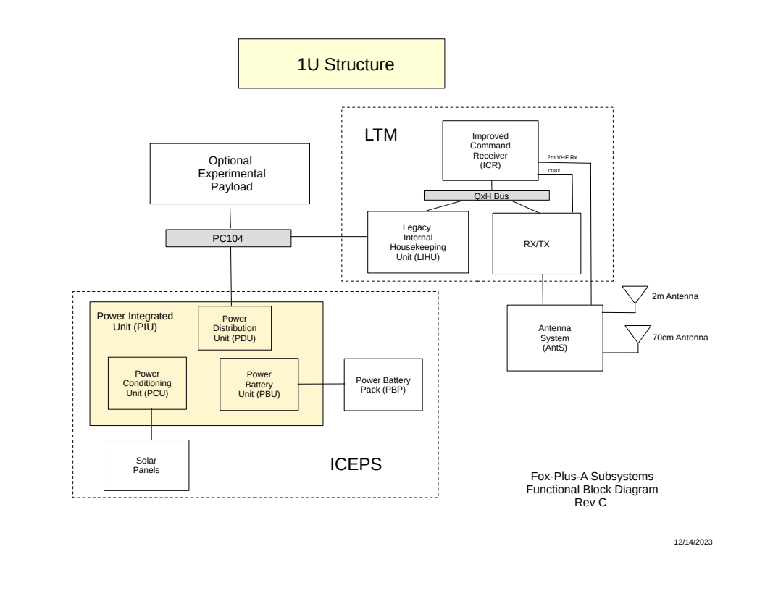
FOX-Plus Project Status Review
FOX-PLUS
Fox-Plus System Overview
8

Slide 9
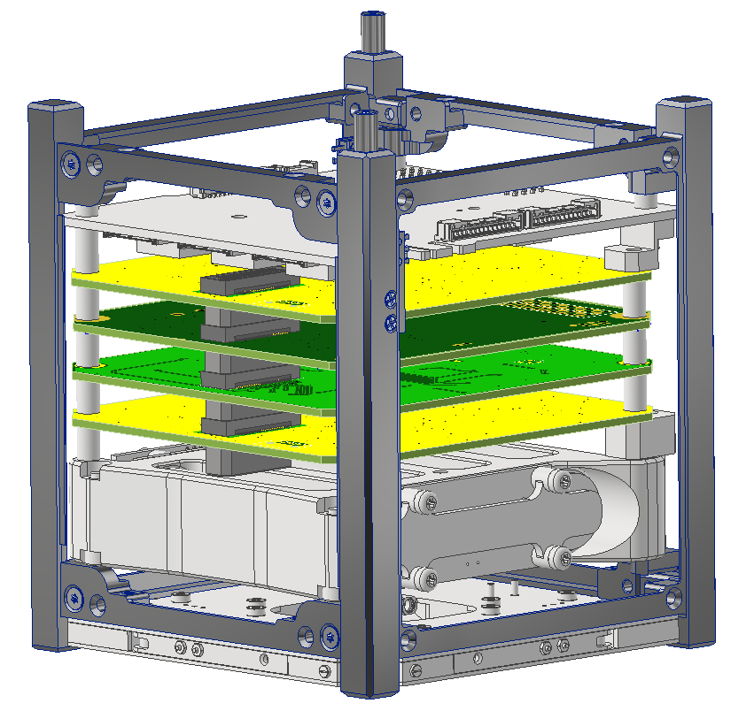
FOX-Plus Project Status Review - Structure
FOX-PLUS
ISISpace 1U Frame
ISISpace Power Integration Unit (PIU)
Adapters
TBD Payload
LIHU
ICR
RXTX
Adapters
ISISpace Power Battery Pack (PBP)
ISISpace AntS
SA’s not shown...obviously
9

Slide 10
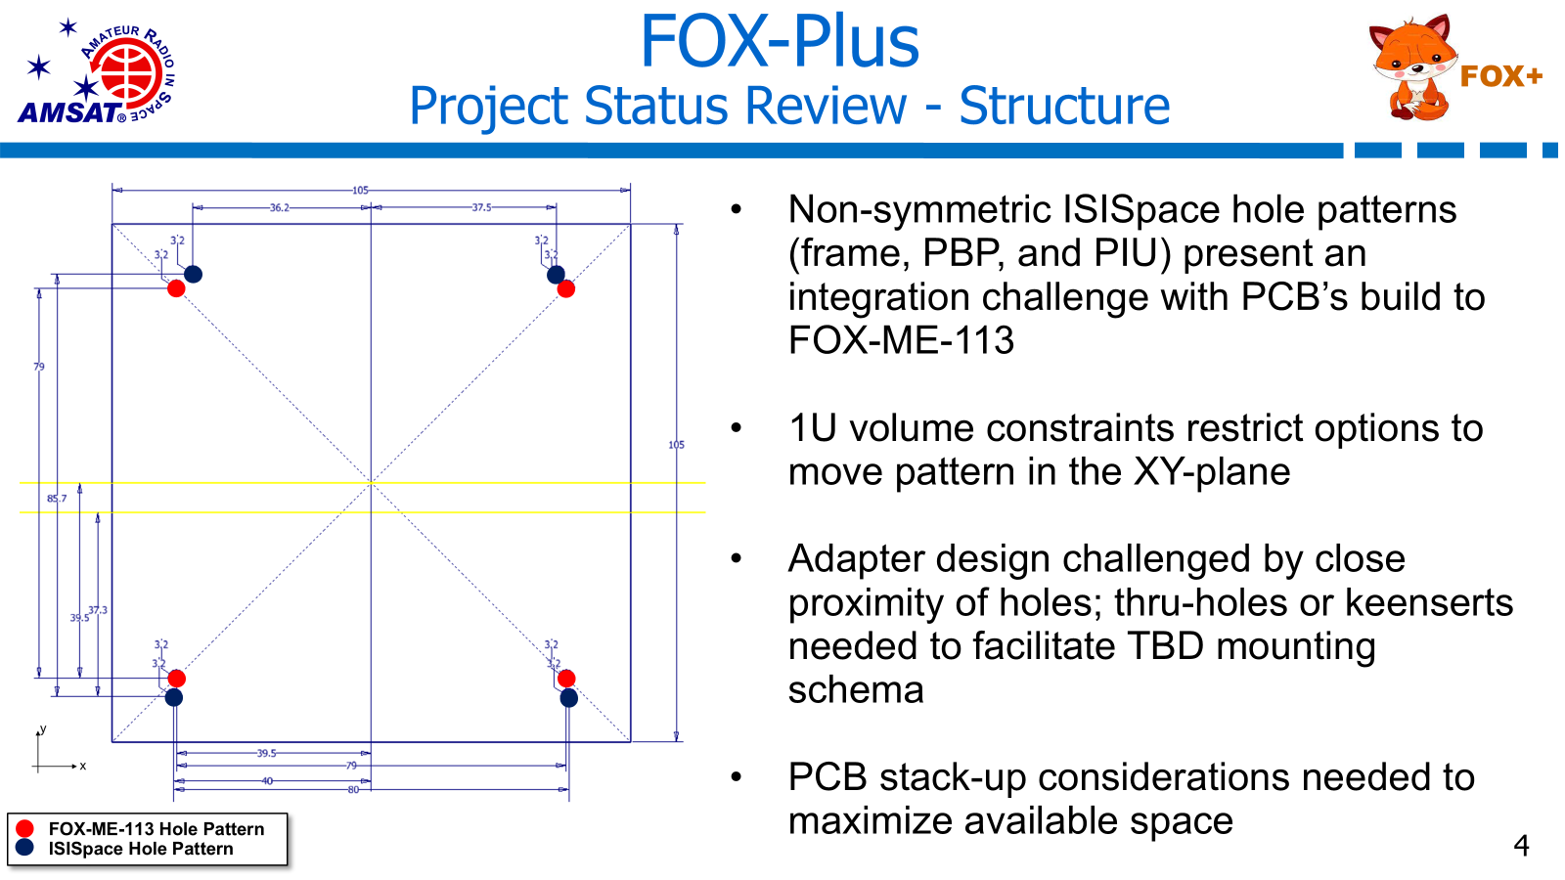

Slide 11
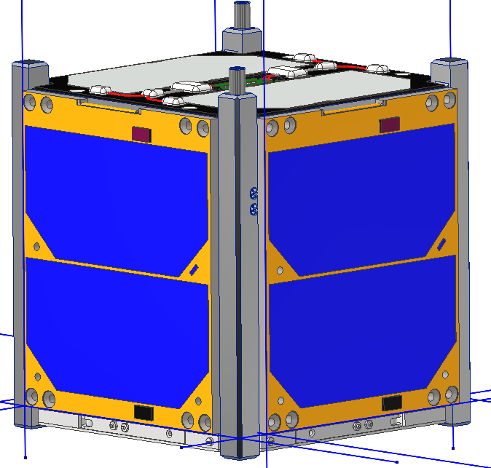
FOX-Plus Project Status Review - Structure
FOX-PLUS
Things To Do (on the road to CDR):
Clean up ISISpace-to-FOX-ME-113 adapter concept
Determine mounting schema – fasteners, threaded rods, keenserts
Perform tolerance stack up – determine tolerancing needs for new parts and potential shimming
Select hardware – material, type, finish, grade
Lay out cable paths
Develop assembly procedures – leverage Autodesk Inventor to lay out steps to put assembly together
Mature MEL / mass properties
Perform analysis – structural, thermal, etc.
Build GD&T drawings for fabricated parts
Snap a baseline in Git-Hub – review and approve design (model and/or drawings) and push to main trunk
Weird blue lines are in the provided SA models
11

Slide 12
FOX-Plus Project Status Review
FOX-PLUS
Structure
Adapter(s) for AMSAT boards into frame Options
Andrew is looking into
Adapters top and bottom of stack as shown in slide 8
Fasteners going different directions (as per Dave’s suggestion at S&S)
- may run into access issues for bolt tightening
Use cabling vice board for electrical
Use hybrid of pcb and cable for electrical
12

Slide 13
FOX-Plus Project Status Review
FOX-PLUS
Hardware: PCB Status
- Improved Command Receiver (ICR) V2.2
PSR #1 Status: ICR design has been updated as follows:
- LNA device change from MICRF3000(now EoL) to MAX2634
- Changed TCXO powering back to earlier version when it was switched based on RX_ENABLE signal. This is a significant power consumption reduction.
- RSSI comparator device changed to a true comparator, not an op-amp
- Baseband audio filter now uses 3 op-amp stages. Response optimized.
- Component layout around SA636 device changed to optimize performance.
- Fudicials added to the PWB to facilitate Contract Manufacturer assembly.
13

Slide 14
FOX-Plus Project Status Review
FOX-PLUS
Hardware: PCB Status - ICR V2.2
ICR v2.2 current status:
One ICR v2.2 board has been fully assembled and 90% tested
- SPI bus connections and A/D functionality not tested yet
Signal connections verified
Design changes to the LNA, SA636 layout, RSSI comparator and baseband audio
filter are fully tested and performing as expected
Two issues have been found that will require another PCB spin:
- Baseband audio signal trace to modem chip is shorted to ground by misplaced
vias
- Device footprint error on D2 causing missing connection
Some other minor tweaks to the design are BoM changes
PCB design update via KiCad should be completed by this weekend so new boards
can be ordered
Plan to assemble and white wire fix a second EM board so there will be 2 EM
boards that could support early S/C EM testing.
14

Slide 15
FOX-Plus Project Status Review
FOX-PLUS
Hardware: PCB Status
- RXTX board
Previous Status: the RXTX board is being worked by Eric.
This work is in progress
Works well on ME-SAT!
Current Status: Dan Habecker building boards.
15

Slide 16
FOX-Plus Project Status Review
FOX-PLUS
Fox-Plus PCB Versions and Status
PCB | Current Version | Fox-Plus-A Version | Status | Responsible Engineer
LIHU | v1.1 | v6 (1.3?) | New boards in approx. 2 wks | Bdale Garbee
ICR | V1.2 | v2.2 | In build / testing | Dave Hartrum
RX/TX | V1.1 | v2.1 | Parts needed for build | Dan Habecker
16

Slide 17
FOX-Plus Project Status Review
FOX-PLUS
Software Development
PSR#1 Status: Will Brozovic and Cliff Jenkins have each setup development tools and have attended training sessions with Burns
Will has IDE Linux machine both working. He can compile and upload the flight software to the IHU he has. Computer runs Ubuntu Linux and he interfaces to the IHU with an STLink.
Cliff has worked on the repositories and has them ready for Fox+ development. He has IDE and Linux machine set up, can compile and upload flight software to the IHU he has onhand. He is currently testing the STLink.
Current Status: both developers are working on aspects of Fox-Plus software development. One area is to trim out unneeded GOLF code.
17

Slide 18
FOX-Plus Project Status Review
FOX-PLUS
Software:
- AMCOM Over-The-Air (OTA) Software
Software application that runs on MS Windows
This software does not need significant changes. A text file defines each satellite including commands and codes available for it. Heimir can make changes for F+ IHU if needed
18

Slide 19
FOX-Plus Project Status Review
FOX-PLUS
Software:
- Fox Telecom – Ground Station Software
This software does not need significant changes and can be done in the future
19

Slide 20
FOX-Plus Project Status Review
FOX-PLUS
Software: Testing
Flight Software: HuskySat flight software used for basic tests and antenna deployment with little modification
- successful testing, including antenna deployment but needs cleanup
AMCOM OTA software modified from HuskySat tested successfully
Telemetry, ground station GUI (Fox-in-a Box) not tested in detail
- verified frames being received, modes indicated properly
20

Slide 21
FOX-Plus Project Status Review
FOX-PLUS
Software: Testing (firmware)
USB Loader - pyMicroloader
Worked with Burns to get pyMicroloader running on my Ubuntu 24.04 test bench PC
- initial problems due to elftools module incompatibility with Ubuntu version or other module. Used Bill Schell’s python tools versions to get it working.
Necessary for me to be able to load flight software versions as I’m the only one with HuskySat LIHU which is necessary for ISIS AntS testing
21

Slide 22
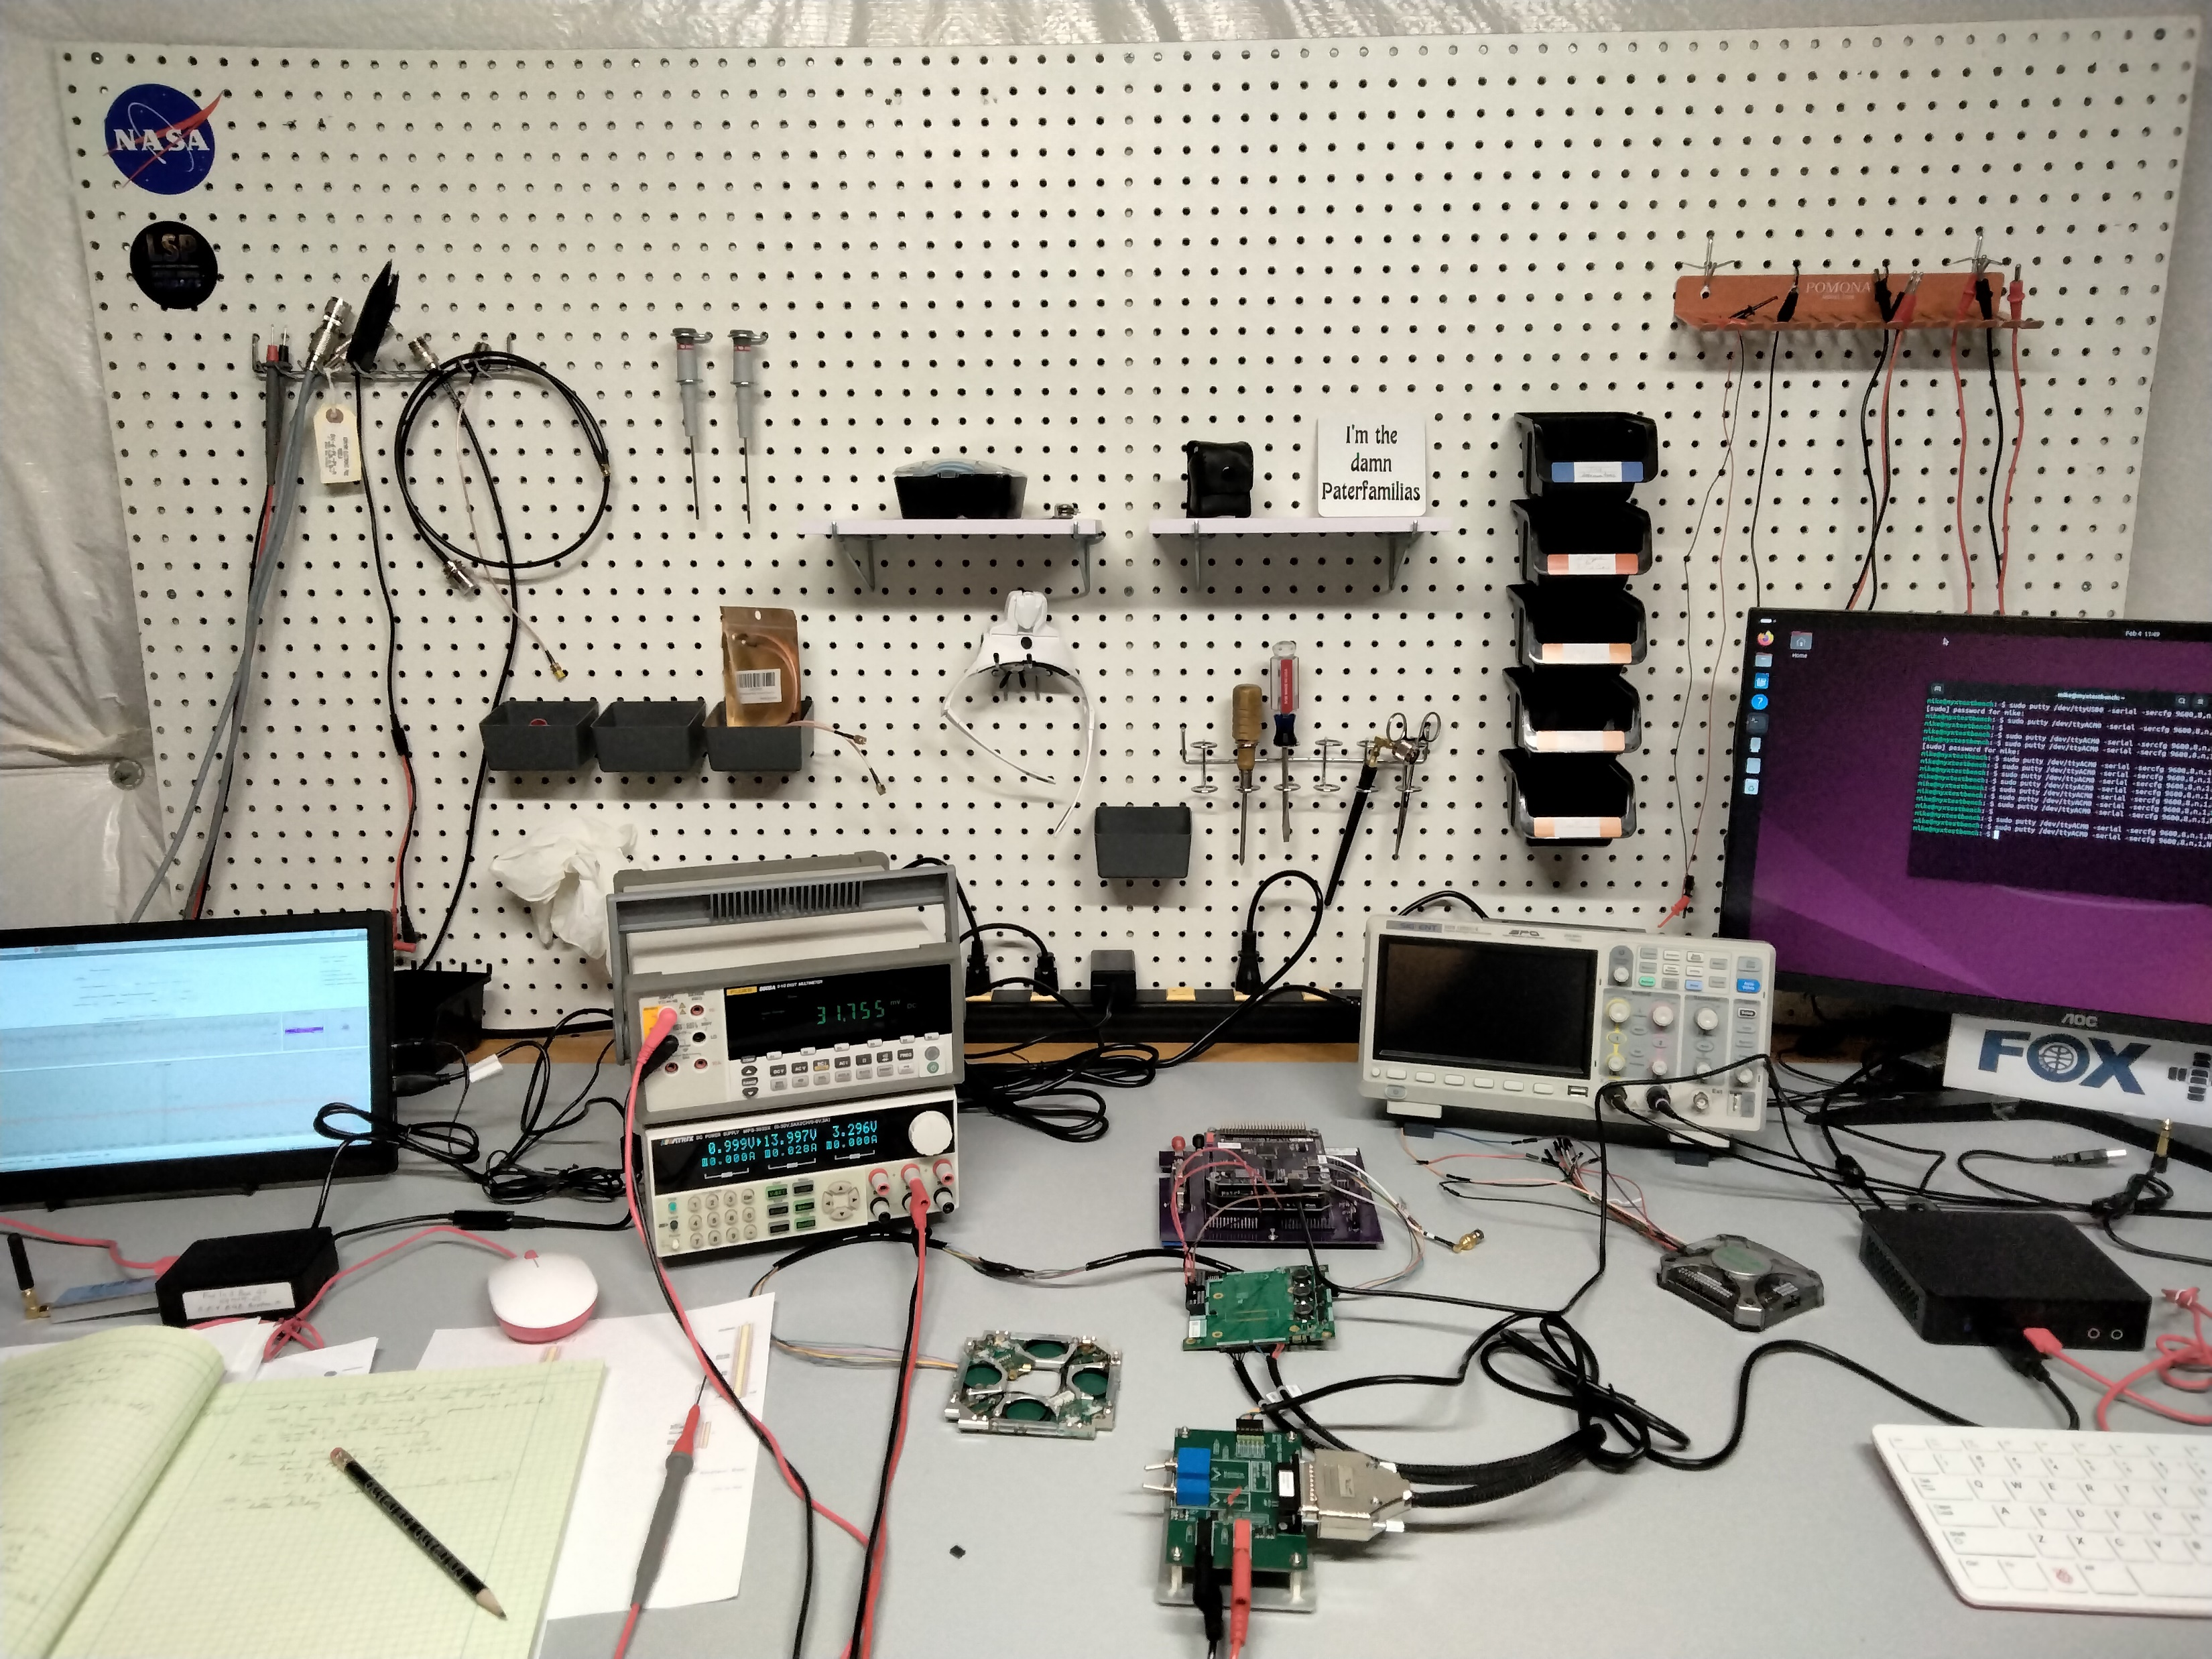
FOX-Plus Project Status Review – Integration & Testing
FOX-PLUS
Fox-in-a-Box
LTM
PC
Power Supply
PIU
Logic Analyzer
AntS
EGSE
22

Slide 23
FOX-Plus Project Status Review
FOX-PLUS
System Integration & Testing – ISISpace EPS Components
Electrical Ground Support Equipment (EGSE) module
- The EGSE is used to switch between bench power supply and batteries to the ISIS Power Integrated Unit (PIU)
PSR#1 Status: this unit has not been interconnected to the Fox-Plus IHU as yet. It cannot be connected to the LIHU due to pins being used contrary to the CSKB “standard”. The I2C software interface has not been tested as it is not yet available
23

Slide 24
FOX-Plus Project Status Review
FOX-PLUS
System Integration & Testing – ISISpace EPS Components
Electrical Ground Support Equipment (EGSE) module
- The EGSE is used to switch between bench power supply and batteries to the ISIS Power Integrated Unit (PIU)
Current Status:
Power to PIU tested using bench power supply
ISIS battery pack charged using bench PS and EGSE
Power to the LTM from the PIU successfully tested using CSKB light (PC104) 5v regulated for v-sys on Feb 3, 2025
24

Slide 25
FOX-Plus Project Status Review
FOX-PLUS
System Integration & Testing
LIHU to ISIS Antenna System (AntS)
PSR#1 Status: We have two AntS. I have one, Andrew has one. I have tested antenna deployment with AMCOM Over the Air (OTA) commands – had minor problem, needed override. Interconnect cable uses expensive Omnetics connectors / cable (more in Fox+ IHU slide)
25

Slide 26
FOX-Plus Project Status Review
FOX-PLUS
System Integration & Testing
LIHU to ISIS Antenna System (AntS)
Current Status:
No change in AntS locations
Omnetics onboard and cable connectors A29100-009, A28000-009 very expensive; replaced with Harwin connectors
- onboard connector to be located on adapter card
- current testing achieved with Omnetics connectors
Software commands for antenna deployment tested and working correctly
Burn wire restring accomplished – ordering more burn wires
26

Slide 27
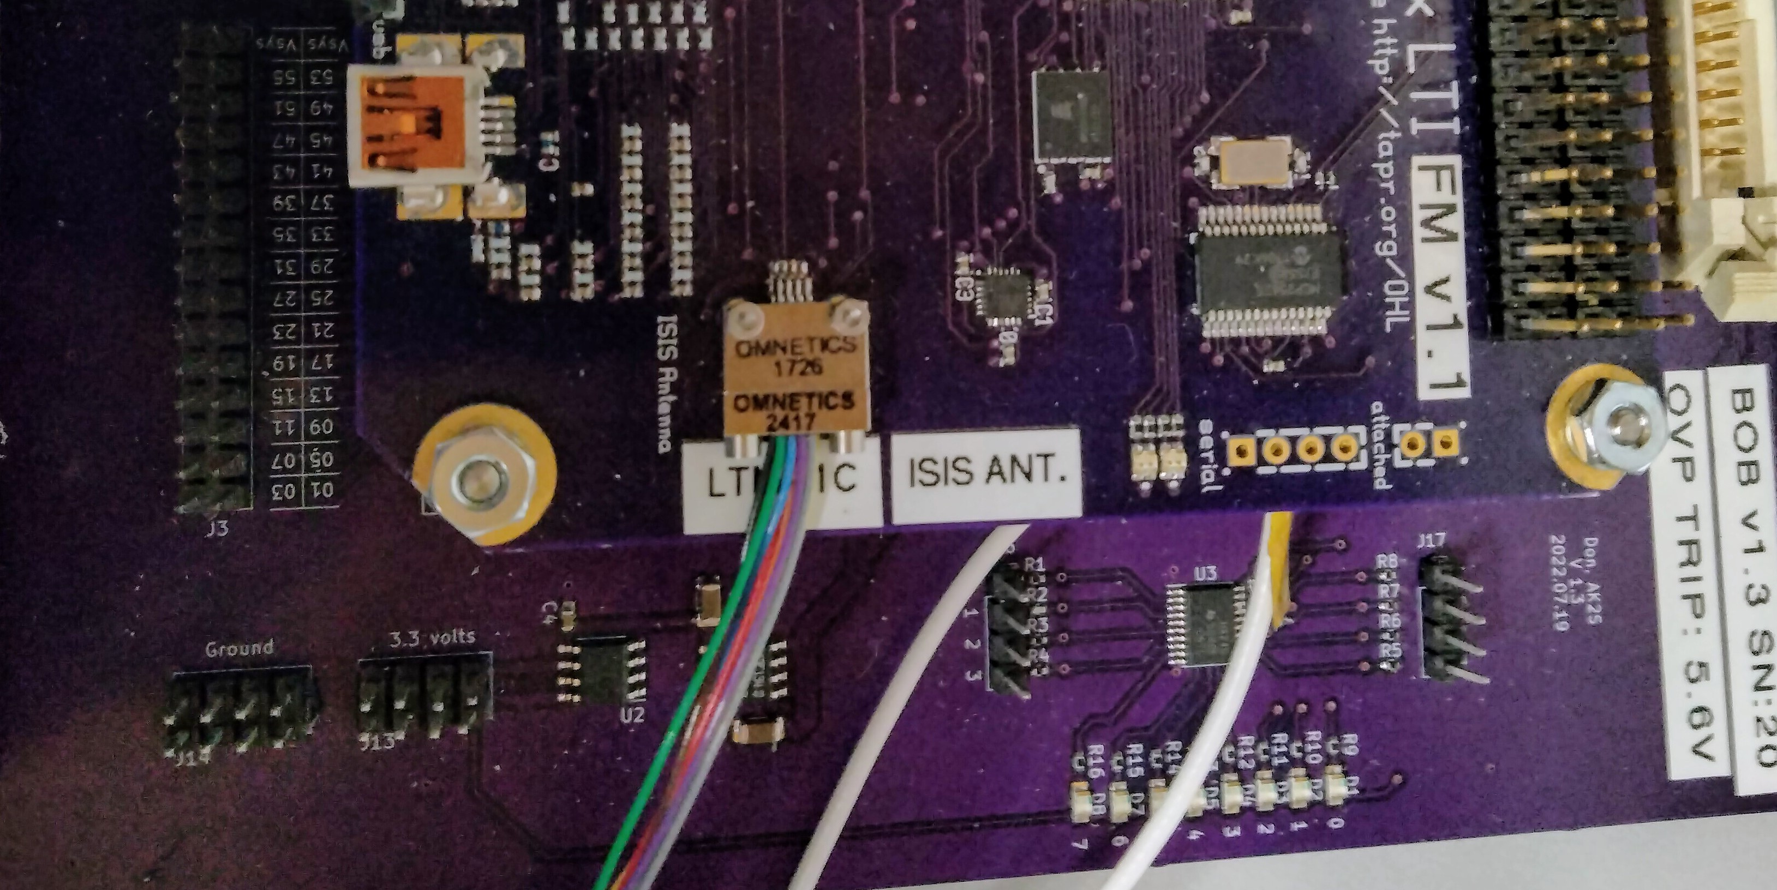
FOX-Plus Project Status Review
FOX-PLUS
System Integration & Testing: Omnetics connector on LIHU
4

Slide 28
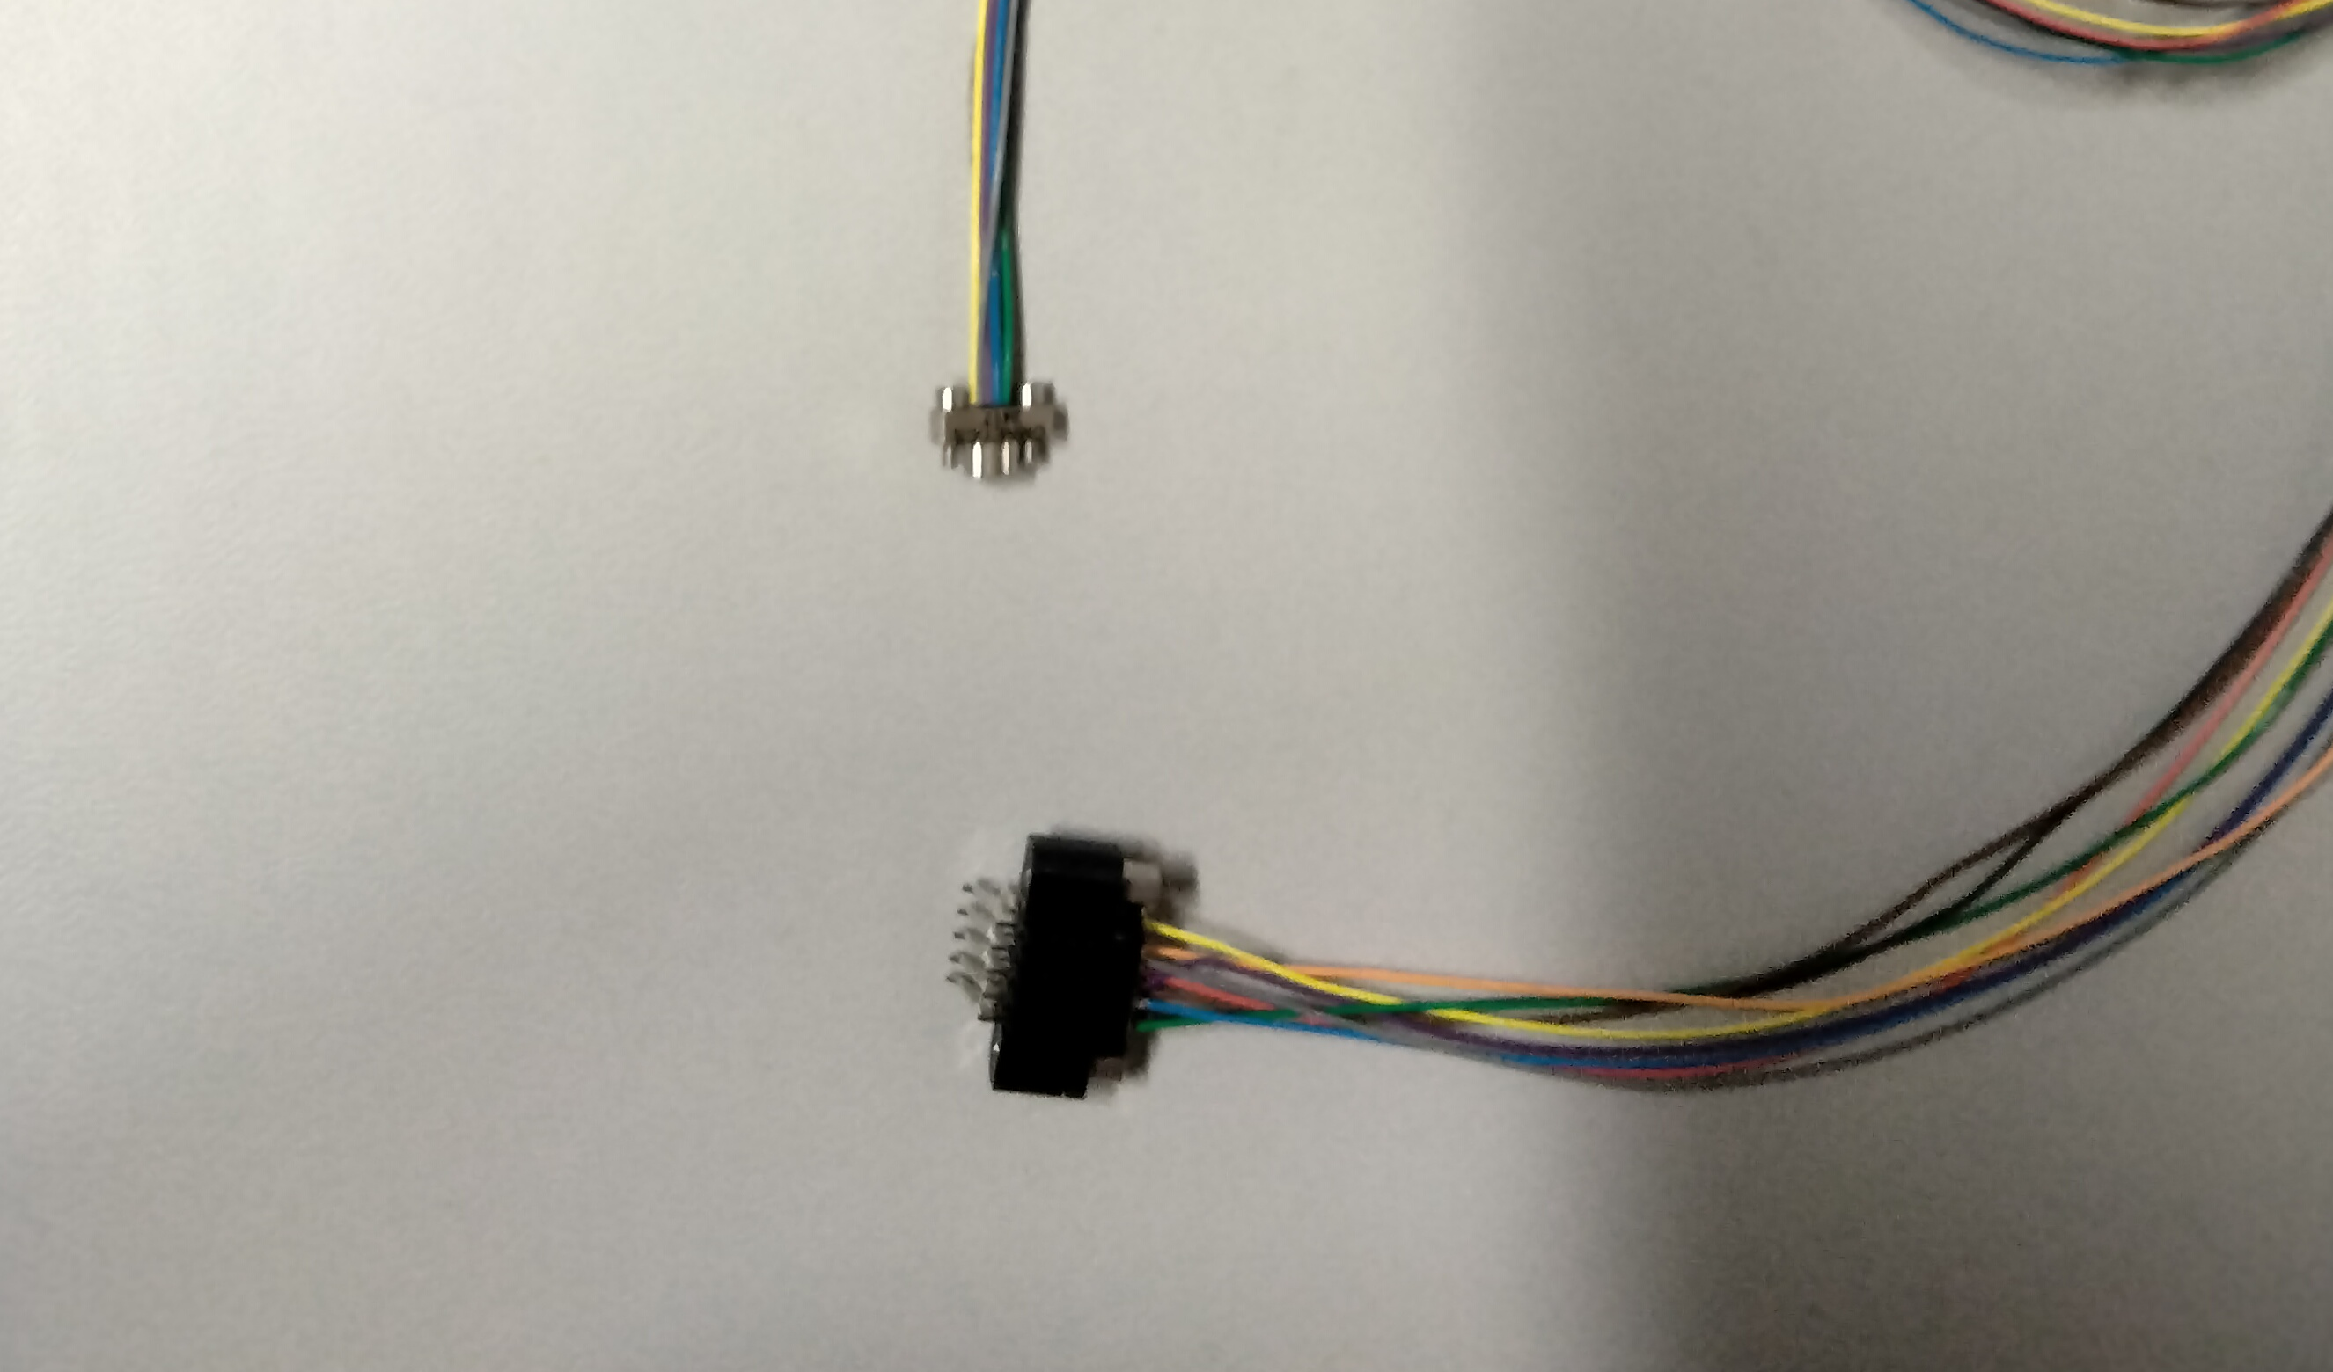
FOX-Plus Project Status Review
FOX-PLUS
System Integration & Testing: Omnetics to Harwin Test Cable
28

Slide 29
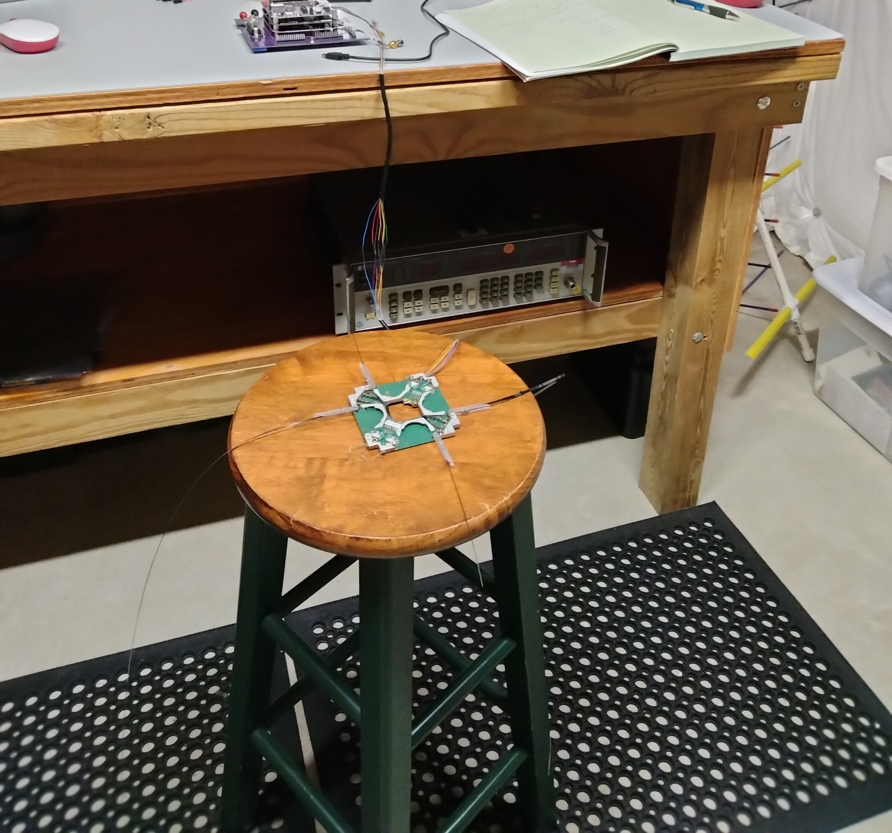
FOX-Plus Project Status Review
FOX-PLUS
System Integration & Testing: Antennas Deployed
29

Slide 30
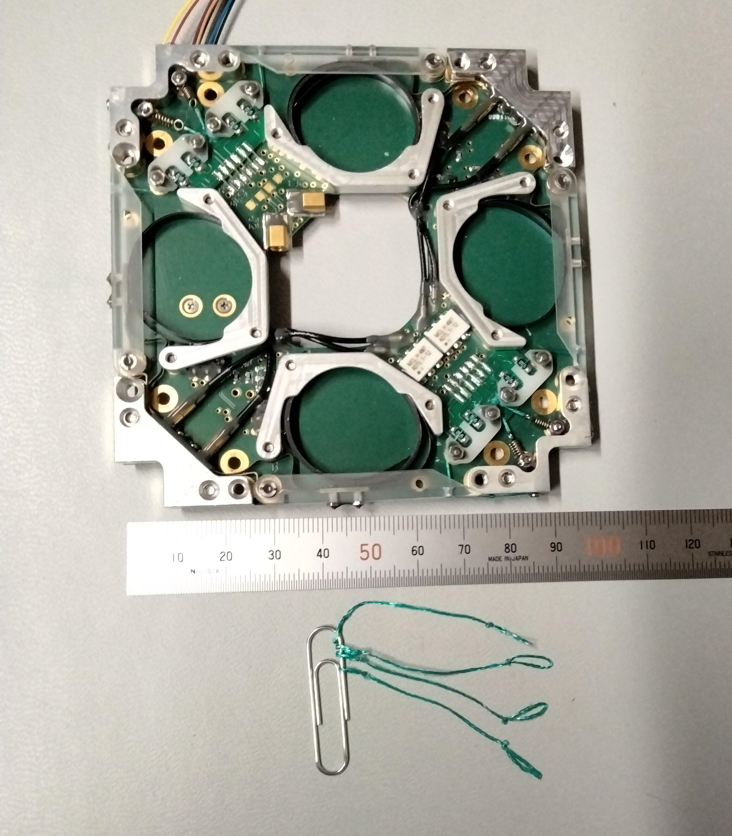
FOX-Plus Project Status Review
FOX-PLUS
System Integration & Testing: Antennas Restrung & Burn Wires
30

Slide 31
FOX-Plus Project Status Review
FOX-PLUS
System Integration & Testing: Preliminary Adapter
LIHU to EPS Adapter
31

Slide 32
FOX-Plus Project Status Review
FOX-PLUS
System Integration & Testing: Adapter Connector Interfaces
> H1, H2: These two 52 pin connectors make up the PC104 and the CubeSat Kit Bus (CSKB) light pin designations
> QSH (J3): Stacking Connector, Fox bus
J4: AntS interface connector
Two I2C busses and One CAN bus are used, also a UART interface
Other connectors / interfaces needed, not yet developed:
1. Umbilical connectors
2. Solar Panel connectors
32

Slide 33
FOX-Plus Project Status Review
FOX-PLUS
System Integration: ISISPACE Solar Panels
Previous Status: Zach is shipping the 10 ISISPACE Solar Panels to me. I will keep 5 and ship 5 to Andrew for EM build.
Current Status: Andrew and I each have one set of solar panels
The solar panels require interface wires to be soldered for integration into the assembled cubesat. Instructions (User’s Manual) have been provided by ISISpace. This has yet to be done.
33

Slide 34
FOX-Plus Project Status Review
FOX-PLUS
Summary: Known Unknowns
Umbilical connector, scheme to charge the batteries and interface UART once the Fox-Plus-A is fully assembled and in dispenser
Solar panel wiring / routing not designed
34

Slide 35
FOX-Plus Project Status Review
FOX-PLUS
V. Summary: Next Steps
Determine and produce the adapter(s) to accommodate AMSAT boards in the ISIS frame
Design and build adapter card to interface the LIHU v6 to the ISIS EPS and AntS
Software: command and response to / from ISIS EPS
Need to get Break Out Boards and LIHUs to Cliff, Patrick, Chris
35

Slide 36
High Level Schedule
2023
2025
2022
2024
202
2026
High Level System Design:
COTS Components (ISISPACE)
SRS
Complete
07 Dec 22
PSR #2
Target
PDR
Jun 24
Target CDR
Sep/Oct 25
Ready for
Launch
Q1
ConOps
Complete
11 Feb 22
Begin Rcv ISISpace Components Jan 24
Eval & Test ISISpace Components
Rcv Solar Panels
21 Oct 2024
Fox-Plus-A
36

